Slide 1
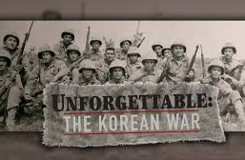
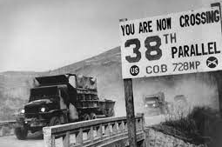
The Korean War

Slide 2
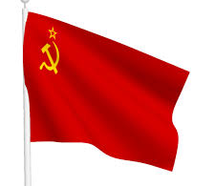
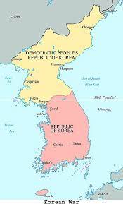
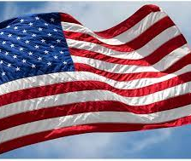
How did the Korean War start?
After Japan’s defeat in WWII, Korea was divided by the Allies at the 38th parallel. (It was basically an imaginary line that cut the country in half.

Slide 3
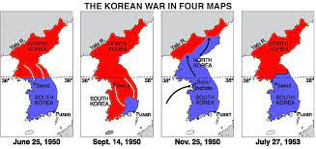
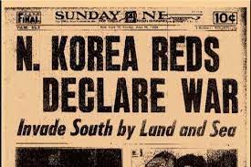
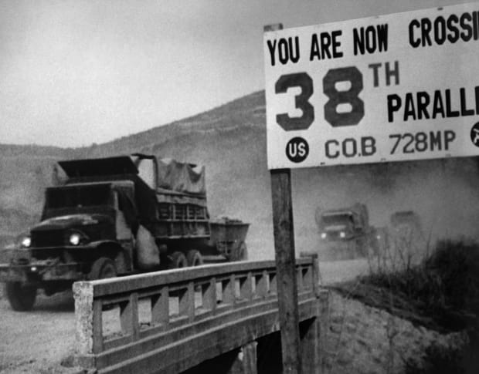
Who started it?
The Soviets occupied North Korea, and Americans occupied South Korea.
In 1950, North Korea invades South Korea.
UN Forces partnered with American and South Korean forces to push into North Korea.
China joins North Korea and pushes the UN/US troops back to the 38th parallel.

Slide 4
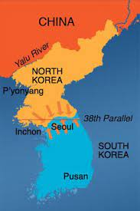
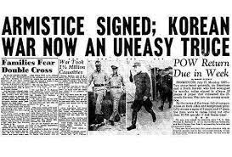
So since no one was winning…
It ends in a stalemate (which is when neither side can gain an advantage or a win)
Armistice (an agreement to officially end the war)

Slide 5
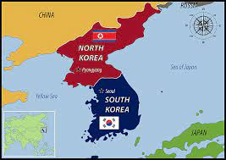
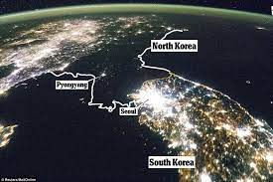
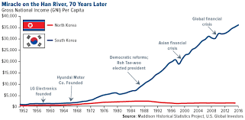
This is how it ends??
So basically, it ends the way it began. North Korea=Communist and influenced by USSR. South Korea=Democratic and influenced by the U.S.
South Korea recovers and prospers with market economy
North Korea is communist and economic growth is slow. They become isolated and poor.

